Slide 1
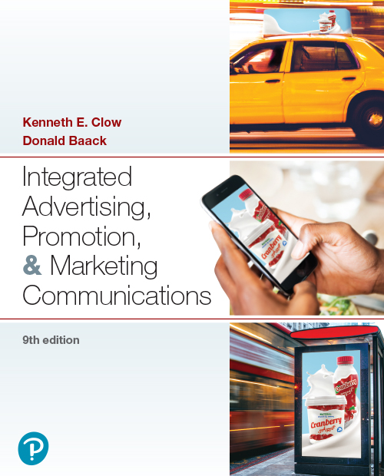

Integrated Advertising, Promotion, and Marketing Communications
Ninth Edition
Chapter 9
Social Media
Copyright © 2022, 2018, 2016 Pearson Education, Inc. All Rights Reserved
Notes:
If this PowerPoint presentation contains mathematical equations, you may need to check that your computer has the following installed:
1) MathType Plugin
2) Math Player (free versions available)
3) NVDA Reader (free versions available)

Slide 2
Chapter Objectives
9.1 What types of social networks assist marketers?
9.2 What characteristics are present in various social media websites?
9.3 What is the nature of social media marketing?
9.4 Which social media marketing strategies do companies employ?
9.5 How can marketers use social media strategies in international operations?
Notes:
These are the objectives for Chapter 9.

Slide 3
Chapter Overview
Social networks that assist marketers
Characteristics of social media websites
Nature of social media marketing
Social media marketing strategies
International issues
Notes:
Chapter 9 opens with a discussion of the most popular social networking sites and the types of social networks that assist marketers. It describes characteristics of social media websites. Next, the chapter addresses the nature of social media marketing and social media marketing strategies. Finally, this chapter examines international issues.

Slide 4
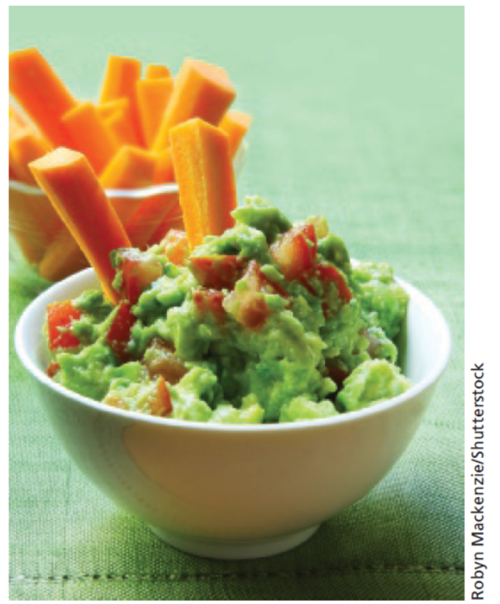
Wholly Guacamole
High pressure processing
Staple item, popular
Leverage social media
Brand alliances
Biggest Loser
Sonic
Disney
Notes:
Wholly Guacamole’s founder, Don Bowden, discovered a high pressure process that results in a “100% all natural, fresh tasting product.” Guacamole is now a popular item that is used on a large number of foods and for sandwich spread. Wholly Guacamole brand was built through leveraging social media to create brand awareness and boost sales. To stretch limited advertising dollars, Wholly Guacamole developed brand alliances with the Biggest Loser television show, Sonic drive-in, and the Disney movie Diary of a Wimpy Kid.

Slide 5
Social Media Terms
Social media – any digital tool or venue that allows for social interaction
Social network – social structure of individuals or organizations
Social media marketing – utilization of social media or social networks to market a product, company, or brand
Notes:
Social media is any digital tool or venue that allows individuals to socialize on the web. A social network is a social structure of individuals or organizations that are tied together in some manner. Social media marketing is the utilization of social media and social networks to market a product, company, or brand.

Slide 6
Figure 9.1: Types of Social Networking Sites
General social networking sites
Niche social networking sites
Business
Family and lifestyle
Dating
Special interests and hobbies
Shopping
Social bookmarking sites
Notes:
General social networking sites are broadly based and are designed to appeal to all demographics. Facebook is an example. Niche social networking sites focus on a specific topic, hobby, interest, or demographic group. LinkedIn is an example of a business niche site. Subcategories of niche sites include business, family and lifestyle, dating, special interests, hobbies, and shopping. Social bookmarking sites allow individuals to share bookmarks of their favorite websites.

Slide 7

Facebook
Largest social media site
2.3 billion users worldwide
Advertising
66% of social media dollars
Custom audience function
Demographics
Teens have declined 25%
Individuals 55+ increased
Usage
Few share details of their lives on a daily basis
Notes:
Facebook is the largest social media networking site with 2.3 billion users worldwide. In terms of advertising, Facebook generates billions each year and captures 66% of social media advertising dollars. Facebook now allows custom audience targeting – which allows marketers to gather information from a company’s website, then use that to target specific individuals on Facebook. Demographically, teens are deserting Facebook, a decline of 25% in the past few years. At the same time the number of seniors, 55 and older, has greatly increased. Usage is concentrated on a small percentage. Only a small percentage share details of their lives on a daily basis. IKEA, shown here, can combine Facebook posts with other forms of advertising to promote the company’s emphasis on sustainability.

Slide 8
YouTube
A video-driven, fast-growing social media site
CoverGirl, Revlon – 99% views consumer generated
Swiffer ad re-creations generate brand interest
Fan-produced videos exceed brand-produced videos
Product usage or repair – videos instead of manuals
Brands must monitor fan-created videos
Notes:
YouTube is a fast-growing social media networking site. Consumers produce the vast majority of videos on YouTube. For instance, for CoverGirl and Revlon, 99% of videos viewed are fan-produced. A new trend is consumers re-creating broadcast ads, such as the Swiffer ads. Some follow the script of Swiffer, others create a variation of the script. Rather than access websites or technical support, many consumers access YouTube to watch how-to videos and repair videos. Brands must monitor fan-created videos. Companies may want to support positive videos. Negative videos may require a response. They also can serve as learning tools.

Slide 9
Figure 9.2: Trends in Consumer Video Sharing
Uploading broadcast ads
Video reviews of products
Re-creation of ads
Creating consumer-produced how-to videos
Capturing real-time events
Creating branded videos
Notes:
Posting videos on YouTube and other video sharing sites has grown tremendously in the last few years. This slide shows current trends in consumer video sharing. Consumers are uploading broadcast ads, especially TV ads, to the internet. Most are ads they like, but some are ones they dislike. Rather than writing a product review, consumers are posting video reviews. Consumers are re-creating ads for popular brands or ads they find appealing. Consumers are posting videos on how to use products or how to repair products. Recently, videos of real-time events are being posted. Most do not involve brands, but occasionally they do. Lastly, consumers are creating branded videos highlighting their personal experiences with a brand.

Slide 10
Instagram
Mobile photo and video sharing
Owned by Facebook
600 million users
Users young, wealthy, and female
60% visit daily
Popular marketing tactics
Contests
Crowdsourcing of photos
Uploading personal photos with branded clothing
Notes:
Instagram is a mobile photo and video sharing website owned by Facebook. It has 600 million-plus users, 60% who tend to visit daily. Users tend to be young, wealthy, and female. Popular marketing tactics include photo and/or video contests and the crowdsourcing of photos. Consumers are also uploading personal photos wearing branded clothing. These are then uploaded to a brand’s page or links are provided from the brand’s website.

Slide 11
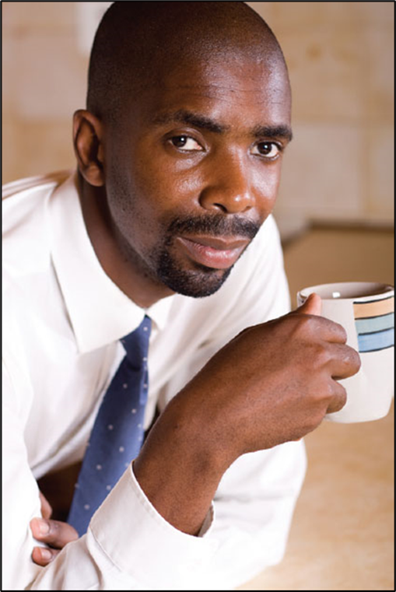
Twitter
Micro-blogging service
Racially diverse and college- educated audience
Effective method of reaching customers
Monitor what customers are saying
Effective for small businesses
Notes:
Twitter is a micro-blogging service that allows individuals and companies to send tweets. Twitter hosts an audience that tends to be racially diverse and college-educated. Twitter can be an effective tool for brands to reach consumers with a message. It can also be used to listen to what consumers say about a brand. Twitter can be an effective means of marketing for small businesses.

Slide 12
Figure 9.3: Tips for Using Twitter
Develop a strategy
Maintain consistent brand voice
Engage followers
Focus on relationships
Respond to customer comments
Avoid total automation
Notes:
Here are some tips for using Twitter. It is critical to develop a strategy to maintain a consistent brand voice. A primary goal is to engage followers and focus on building relationships, not on pushing sales. It is important to respond to customer comments, both good and bad. Brands should avoid total automation as this will soon become evident to followers and they will lose credibility.

Slide 13
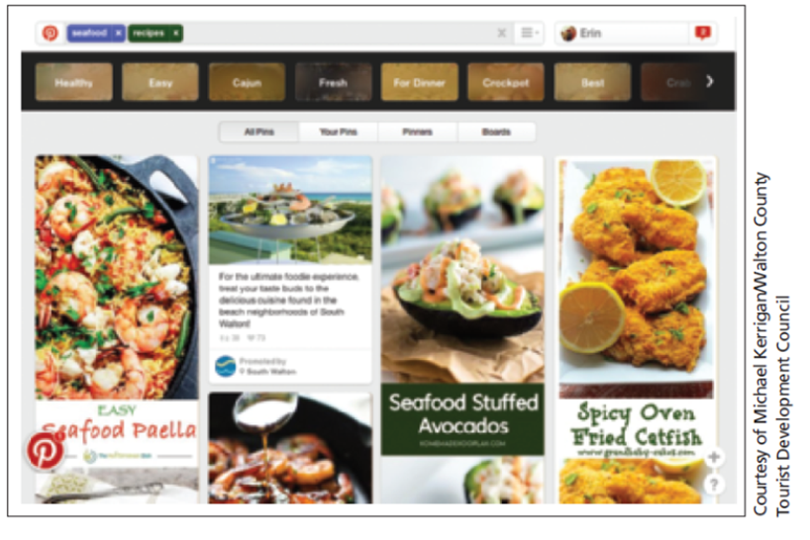
Pinterest
Bulletin-board style social network
250 million users
Popular topics
Fashion
Dining
Notes:
Pinterest is a bulletin-board style social networking site with over 250 million users. Popular topics are fashion and dining. In this post, Starbucks utilized Twitter for a successful campaign entitled “Tweet-a-coffee.”

Slide 14
Snapchat and TikTok
Snapchat
“Snaps” viewable for only a set time
Popular with teens and millennials
Unique platform for marketers
TikTok
Fast-growing social media platform
Second-most non-gaming app downloads in 2019
Biddable ad space available
Notes:
Snapchat offers a unique platform for marketers. Research indicated that 45% of college students would open snaps from an unknown brand and 73% open snaps from a known brand. TikTok is one of the fastest growing social media platforms. It has achieved nearly legendary status. TikTok provides biddable ad space through its “managed service platform.”

Slide 15
Social Media Marketing (1 of 4)
Increase traffic and assist mobile marketing efforts
Enhance brand image
Solve problems
Provide information
Online interactions impact brand perceptions
Improve search rankings
Notes:
Social media can increase traffic and assist with mobile marketing efforts. To enhance a brand’s image, social media must do more than just offer communication opportunities. Brands must solve consumer problems, provide information, and offer insights into product usage. According to JD Powers, online interactions impact brand perceptions, either positively or negatively. Social media helps boost organic search rankings with
search engines.

Slide 16
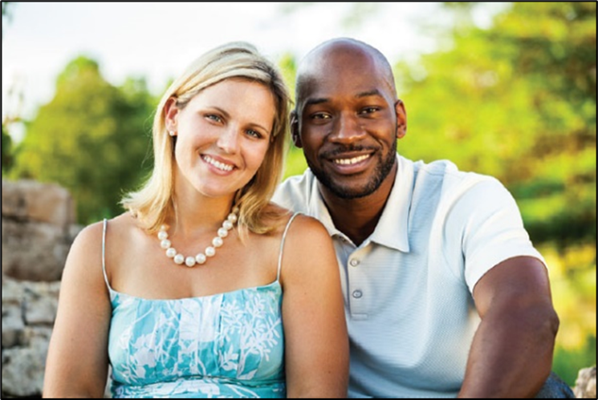
Social Media Marketing (2 of 4)
Customer intelligence.
Social listening, social chatter
Provides insight into customer thoughts
Offers ideas for branded content
Social buzz may require a response
Notes:
Customer intelligence involves social listening or listening to social chatter. Social listening offers an excellent source of ideas for branded content. It also provides insight about customer thoughts, both negative and positive. Most comments are honest and reveal what individuals think. Occasionally, social buzz requires a brand reaction, such as the case with General Mills. A Cheerios ad featured a mixed-race marriage. When posted to YouTube, the ad received a large number of views and some negative, racist comments. General Mills believed these comments represented a minority so disabled the comment feature, but did not discontinue the ad.

Slide 17
Figure 9.4: Functions of Social Listening
React to negative feedback
Detect problems
Gather topics for branded content
Predict trends
Detect patterns or shifts in views
Identify brand advocates
Notes:
Social listening allows a firm to react to negative comments made by individuals. Social listening can be used to detect problems with the product. It can also be used to gather ideas for branded content because it will show problems people are facing. Social listening can be used to detect consumer behavior patterns or shifts in consumer views and to predict trends. Lastly, social chatter can identify brand advocates, individuals who really love a brand.

Slide 18
Social Media Marketing (3 of 4)
Identify consumer advocates
Small number of fans generate most social buzz
Most customers do not make comments
Brand advocate characteristics
Behavioral commitment
Emotional connection
Quality communication skills
Notes:
One purpose of social listening is to identify consumer advocates. The majority of customers do not make comments about a brand on social media. Nearly all social buzz is generated by a small number of fans. Brand advocates should be recruited. Characteristics of brand advocates include a behavioral commitment to the brand, emotional connection to the brand, and quality communication skills.

Slide 19
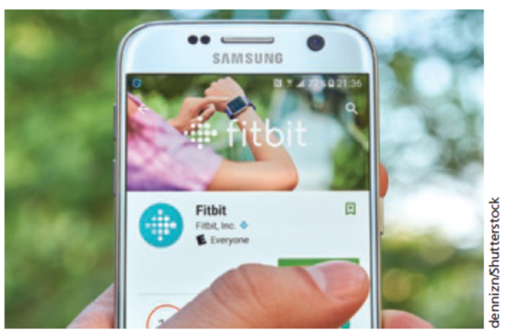
Social Media Marketing (4 of 4)
Build brand loyalty
Ultimate marketing goal
Engage customers
Provide an alternative outlet
Complement traditional media channels
Be cautious in equating buzz with sales impact
Notes:
Developing brand loyalty and increasing sales constitute the ultimate goals of any marketing program, including social media marketing. Marketers should design social media programs to engage consumers. Increasing sales should be viewed as a by-product of social media marketing. Social media posts can complement and supplement content delivered via traditional media. However, caution is in order. A recent Coca-Cola study suggested that online buzz, or talk on social media about the brand, did not lead to any measurable impact on sales. This new landscape presents significant challenges to those engaged in social media marketing.

Slide 20
Questions to Consider (1 of 2)
Think of a couple of your favorite social media channels (Facebook, YouTube, Instagram, etc.)
Now think of all the social media marketing functions we just discussed.
Which of these social media channels do a good job of marketing their brand to you?
Which of the above functions do they use in their marketing efforts?
Notes:
For these questions, encourage students to think about the social media channels they use most and their favorite brands. What resonates with them as consumers?

Slide 21
Figure 9.5: Reasons Consumers Follow Brands
Keep up with activities
Learn about products or services
Sweepstakes or promotion
Provide feedback
Join community of fans
Make purchases
To complain
Notes:
The top two reasons consumers follow a brand are to keep up with the brand’s activities and to learn about new products and services. Sweepstakes and promotions can entice some consumers to follow a brand. Fans of a brand may provide positive feedback. If someone likes a brand, they may follow it in social media to interact with other fans and to make purchases. Customers who have had a poor experience typically do not follow a brand but may complain about the brand in social media.

Slide 22
Figure 9.6: Social Media Strategies
Content seeding
Real-time marketing
Video marketing
Influencer marketing
Interactive blogs
Consumer-generated reviews
Viral marketing
Notes:
This slide outlines some basic social media marketing strategies. Setting goals enhances the probability of success for social
media marketing investments.

Slide 23
Figure 9.7: Building a Social Media Presence
Determine social media goals
Determine online personality
Decide on social media platforms
Develop social media strategies
Develop an analytical feedback loop
Notes:
This slide shows the steps involved in building a social media presence. It starts with determining the social media goals. The type of goal set determines the best strategies. Once goals have been set, then determine the online personality the company wants to convey in social media and then decide on the social media platforms. Social media strategies are chosen based on the goals, online personality, and social media platforms. The last step is to develop an analytical loop that examines data from social media to make changes in what is happening with social media.

Slide 24
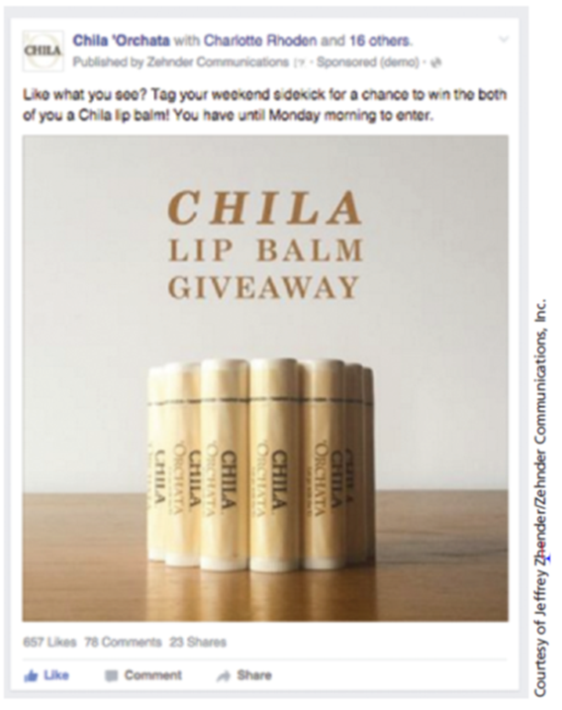
Content Seeding
Provide incentives to encourage sharing
Financial incentives
Coupons
Rebates
Contests
Esurance post-Super Bowl ad
Value-added incentive = Exclusivity
Notes:
Just as plants grow from seeds, marketers can plant seeds that consumers will then share with others. Financial incentives are the most common and have the best track record of working. Coupons, rebates, and contests are often used. Occasionally, a mistake can be a seed for a brand. Esurance purchased an ad after the Super Bowl for $2.5 million and then held a contest offering $1.5 million. Value-added incentives used by brands include some type of exclusive information or benefit.

Slide 25
Behavioral Targeting
Identifies person’s browsing history
Often used on social media sites
Most often text-based
Can also be image-based
Both approaches work well
Notes:
Marketers employ behavioral targeting with social media in the same manner as it is used with digital marketing. The most common social behavioral targeting strategy involves identifying a person’s browsing history. Instead of using text-based behavioral search, Coca-Cola utilized an image recognition engine to search photos individuals had posted on Facebook, Instagram, and Twitter. Both approaches work the same because they send ads to individuals based on what they post or search on social media.

Slide 26

Real-Time Marketing
2013 Super Bowl – Oreos
Instantaneous marketing message
Live event
Upfront strategic planning
Maintain brand image
Notes:
Real-time marketing is the creation and execution of an instantaneous marketing message in response to or during a live event. It began as a legitimate strategy in the 2013 Super Bowl when Oreo cookies sent out a tweet during a blackout. Now brands have “war rooms” where company experts gather during a live sporting event. War rooms look for opportunities to create and send out marketing messages. To be successful, however, there needs to be upfront strategic planning as well as policies and rules governing real-time marketing messages. A natural event, such as a snowstorm, can also be used for real-time marketing.

Slide 27
Video Marketing
60% of U.S. population watch videos
75% of internet users watch videos
Growing faster than any other advertising form
Consumers more receptive to online videos
Many companies maintain YouTube channels
Informational or instructional videos useful
Vloggers create videos, build followings
Notes:
Video marketing has increased in popularity. About 60% of US population watch videos and 75% of internet users watch digital videos. Spending on advertising in videos on sites such as YouTube has risen at a rate faster than any other form of advertising. Individuals watching digital videos are more receptive than individuals watching TV ads, and they watch the ads longer.

Slide 28
Location of Video Ads
Pre-roll
Higher impressions
Enhance recall
Mid-roll
Higher completion rate
Enhance brand recognition, brand image
Post-roll
Higher click-through rate
Direct response, call to action ads
Notes:
Video ads that are pre-rolled have a higher level of impressions and are good to enhance brand recall. Mid-roll ads have the highest completion rate and are good to enhance brand recognition and brand image. Post-roll ads have a higher click-through rate and are good for direct response ads and ads with a call-to-action of some type.

Slide 29
Figure 9.8: Video Tactics
Advertising on videos
Posting of television ads
Informational videos
Cause-related videos
Product reviews
Vloggers
Notes:
Brands have a variety of video marketing tactics from which to choose.

Slide 30
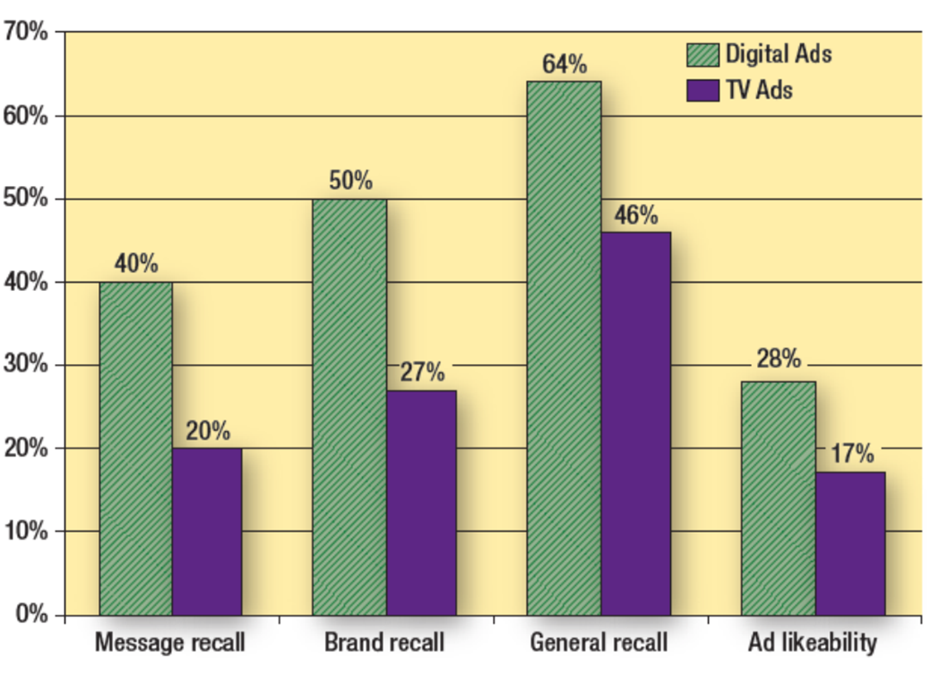
Figure 9.9: Online Ads versus Television Ads
Notes:
The legend shows green representing digital ads and violet representing T V ads. The y axis ranges from 0 to 70 percent. The x axis shows grouped vertical bars from left to right with labels and values as follows.
Message recall, green 40 percent, violet 20 percent
Brand recall, green 50 percent, violet 27 percent
General recall, green 64 percent, violet 46 percent
Ad likeability, green 28 percent, violet 17 percent

Slide 31
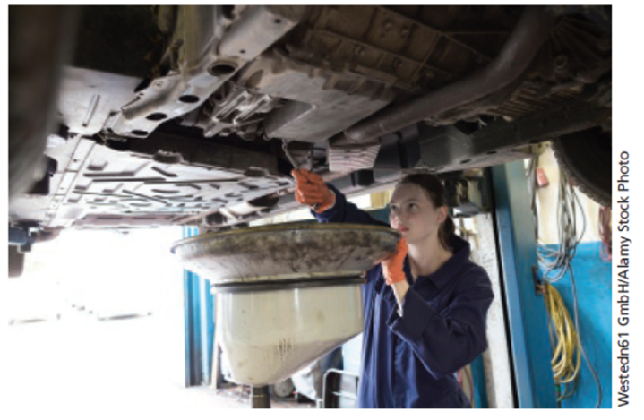
Influencer Marketing
Individual marketing a brand
Match opinion leaders with brands
Number of followers not always key
Lead conversations and shape opinions
Align brand message, influencer’s motivation
Authenticity important
Notes:
Because most brand content is ignored, brands are using influencer marketing, which is individuals posting positive comments and information about brands. It is important to match opinion leaders with brands where the brand message is aligned with an influencer’s motivation. Number of followers not always a key to success. Most important is if they lead conversations and shape opinions. To be effective, influencers must be seen as authentic. As shown here, influencer marketing extends to many audiences, including those interested in automobile repairs.

Slide 32
Questions to Consider (2 of 2)
What do you think about using children as influencers?
Which products or services might be useful for this?
What are the key ethical implications?
As a marketer, would you use children as influencers? Explain your thinking.
Notes:
One area of controversy involves children as influencers. This area of marketing is largely unregulated, leading to criticisms that using kids basically boils down to exploitation, by companies, parents, and social media outlets. Try to probe students’ thinking here.

Slide 33
Interactive Blogs
Internet provides platform for
Dissatisfied consumers
Satisfied consumers
Interactive blogs enable two-way communication
Higher level of risk
Face criticism honestly and humbly
Seek solutions to problems, issues
Notes:
The internet provides a platform for consumers to vent their feelings. In the past, a dissatisfied customer told 12-15 friends and relatives, now he/she can tell thousands or even millions via social media. Satisfied customers also have the opportunity to share their feelings. Interactive blogs allow visitor comments. By doing so, brands have a higher level of risk since they cannot control what individuals post. Decisions do have to be made, however, on how the brand will handle negative comments. The best approach is to face any criticism honestly and humbly and react by seeking a solution to the problem or cause of the dissatisfaction.

Slide 34
Figure 9.10: Types of Interactive Blogs
Brand blog
Individuals sponsored by a brand
Individual speaking about a brand

Slide 35
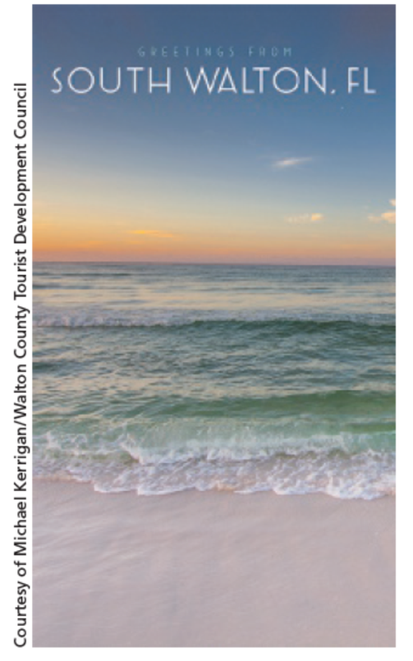
Consumer-Generated Reviews
Amazon.com leads the pack
Best Buy uses online reviews in retailing
Provide important information
Challenge – managing reviews
Notes:
Consumer-generated reviews have grown in popularity. The leader is Amazon.com, which provides reviews on most books and items sold. Amazon encourages customers to write reviews for other customers. Best Buy also offers customer reviews on various brands. Customer reviews are a good way to reach early adopters. Customer reviews can have some negative implications if a company or brand receives negative reviews and low-star ratings. This information can be used for developing marketing plans, modifying products, and creating service strategies. Customer reviews have driven companies to focus more on consistent product quality. Consumer-generated reviews are important in influencing tourist decisions to try new locations for places such as South Walton, Florida promoted here on Snapchat.

Slide 36
Viral Marketing
Message passed from one consumer to another
Email
Blogs
Form of advocacy or word-of-mouth endorsement
Viral marketing messages
Advertisements
Hyperlinked promotions
Online newsletters
Streaming videos
Games
Notes:
Viral marketing involves passing along a marketing message to others in some way. It can be through an email or on a blog. It is a form of word-of-mouth endorsement. Viral messages can be advertisements, hyperlinks to promotions, online newsletters, streaming videos, or games.

Slide 37
Figure 9.11: Keys to Successful Viral Marketing
Focus on the product or business
Determine why individuals would want to pass along the message
Offer an incentive
Make it personal
Track the results and analyze the data
Notes:
To create successful viral marketing programs requires a focus on the product or business. Viral marketing needs to be related in some way to the brand. The business must seriously think about why individuals would want to pass the message along. What makes the message unique or different? It has to be fun and cause a person to say, “I’ve got to send this to my friends. They have to see it.” An incentive can be offered, but that does not always work because it is seen as a sales trick. The viral message should be personal in some way. It is important to track results and analyze the data to see what worked and what didn’t, and what people did with the viral message.

Slide 38
International Implications
Social media interactions worldwide
Most Facebook users outside U.S.
Language differences
Social norms
Technological challenges
Notes:
Social media is worldwide with users from almost every country. Facebook has more users outside the United States. Companies face three challenges: language differences, social norms, and technological issues.

Slide 39
Your Career: Social Media
Examine your social media accounts
Build a personal social profile now
Listen to what others say about your social media
For companies of interest, access and participate in their social media
Notes:
Social media is a powerful force in today’s society and does have an impact on your career, for good or bad. You cannot hide from social media. It is powerful. Embrace it. Use it to build your personal social image.

Slide 40
Blog Exercises
Gillette
Dove
Honest Tea
Notes:
The blog exercises for Chapter 9 include Gillette, Dove, and Honest Tea.

Slide 41

Copyright
This work is protected by United States copyright laws and is provided solely for the use of instructors in teaching their courses and assessing student learning. Dissemination or sale of any part of this work (including on the World Wide Web) will destroy the integrity of the work and is not permitted. The work and materials from it should never be made available to students except by instructors using the accompanying text in their classes. All recipients of this work are expected to abide by these restrictions and to honor the intended pedagogical purposes and the needs of other instructors who rely on these materials.

